Slide 1


Slide 2
Agenda
Objective of the Project
ER Diagram and schema explanation
Key analysis questions (use cases)
SQL query results with screenshots or summaries
Final business insights and recommendations
Conclusion (Key finding overall)
Q&A Slide
Your Experience/Challenges working on SQL – Data Analysis Project.

Slide 3
What is SQL?
SQL (Structured Query Language) is the industry-standard language used to interact with relational databases.
It allows you to create tables, insert data, retrieve information, update records, and manage database security and structure.
Why SQL is Important?
Databases store data for websites, apps, and organizations.
SQL allows you to:
Add new data (INSERT)
Get data (SELECT)
Update data (UPDATE)
Remove data (DELETE)
It’s used in data analysis, software development, business intelligence, etc.

Slide 4
Objective
The objective of a Library Management System is to simplify and automate library tasks such as managing books, users, issuing and returning books, and tracking due dates and fines. It helps librarians work more efficiently and allows users to easily search, reserve, and borrow books. The system also ensures accurate record-keeping, reduces manual errors, and improves overall library service and organization.

Slide 5
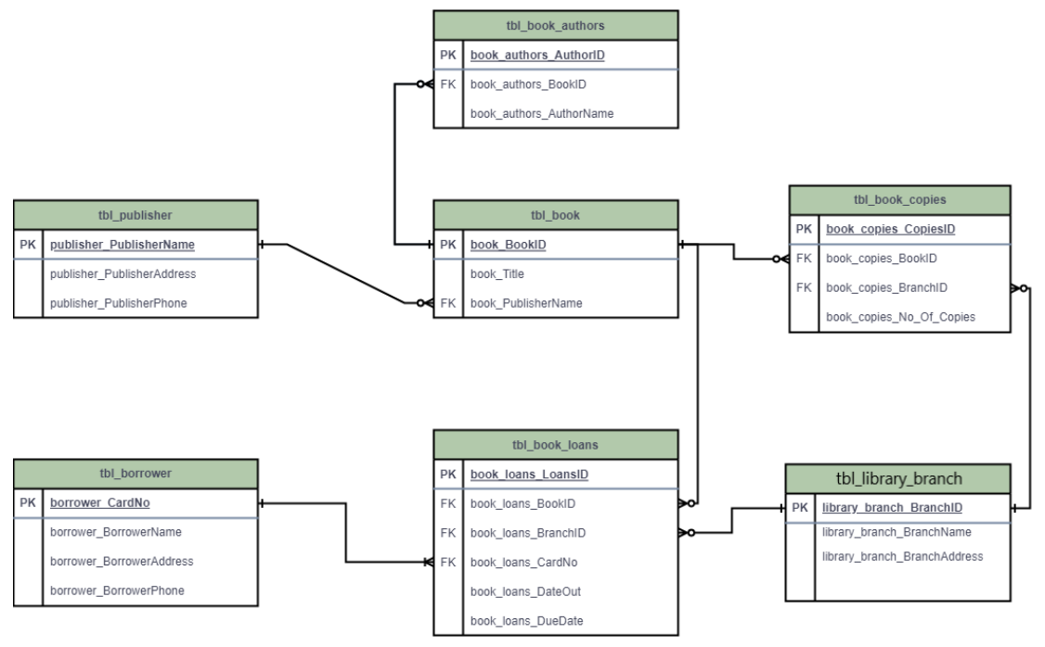
ER Diagram

Slide 6
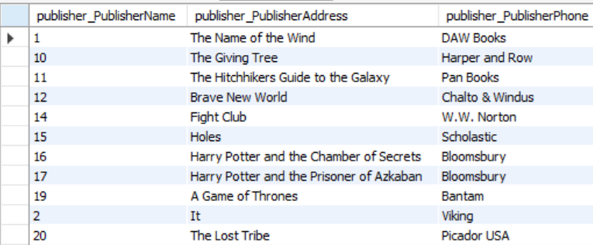
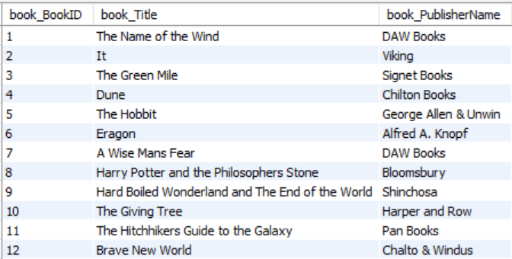
Tables
Publisher Books

Slide 7
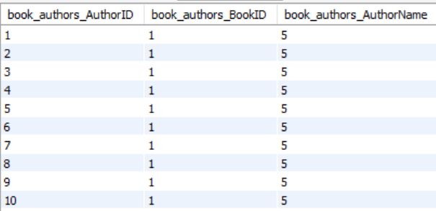
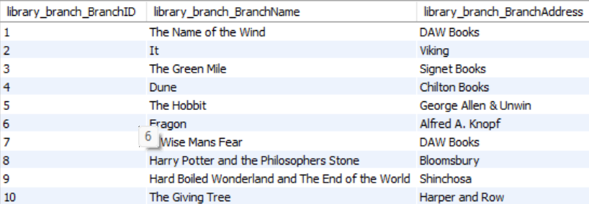
Book authors
Branch

Slide 8
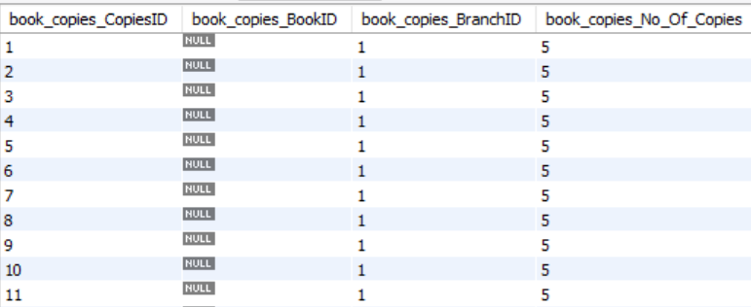
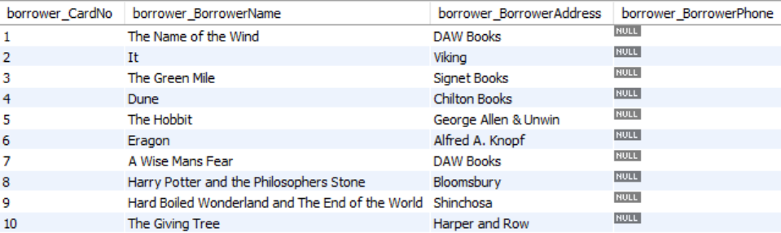
Book copies
Borrower

Slide 9
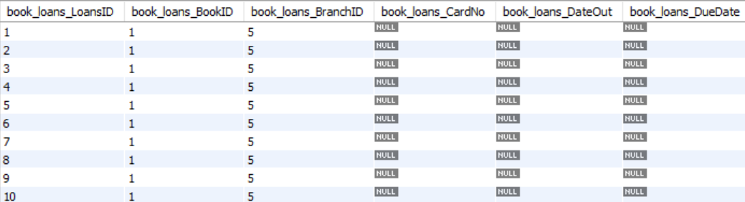
Book loans

Slide 10
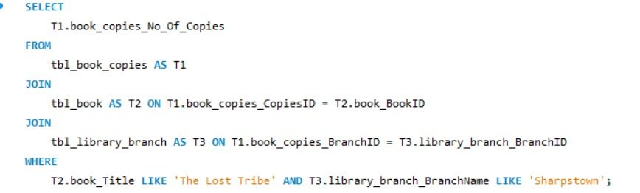
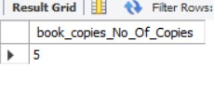
1.How many copies of the book titled "The Lost Tribe" are owned by the library branch whose name is "Sharpstown“?
Query:
Output:

Slide 11
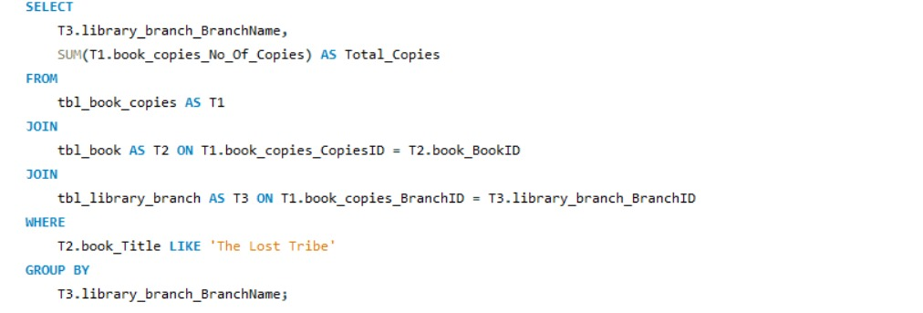
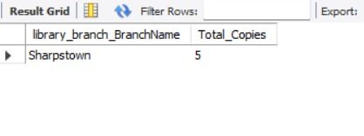
2.How many copies of the book titled "The Lost Tribe" are owned by each library branch?
Query:
Output:

Slide 12
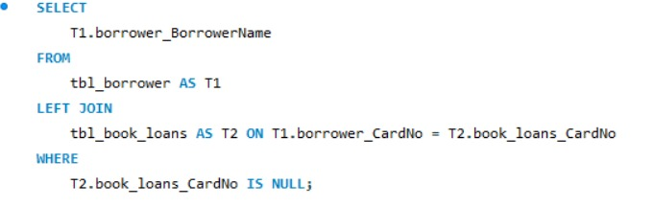
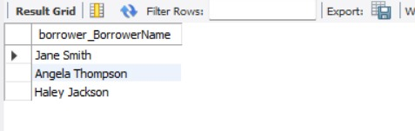
3.Retrieve the names of all borrowers who do not have any books checked out.?
Query:
Output:

Slide 13
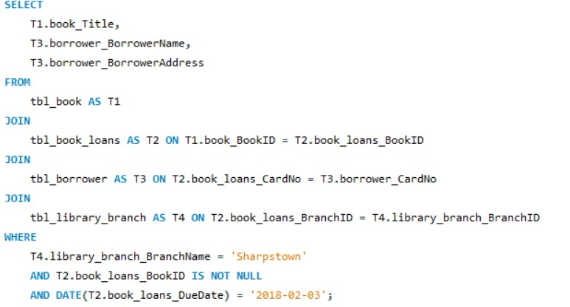
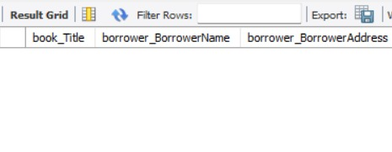
4.For each book that is loaned out from the "Sharpstown" branch and whose Due Date is 2/3/18, retrieve the book title, the borrower's name, and the borrower's address.?
Query:
Output:

Slide 14
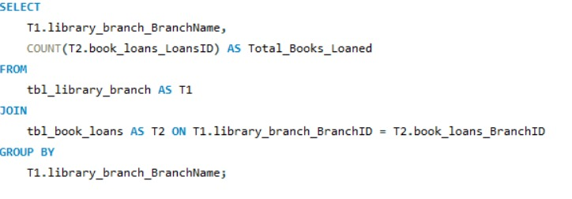
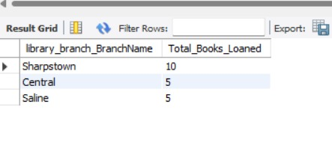
5.For each library branch, retrieve the branch name and the total number of books loaned out from that branch.?
Query:
Output:

Slide 15
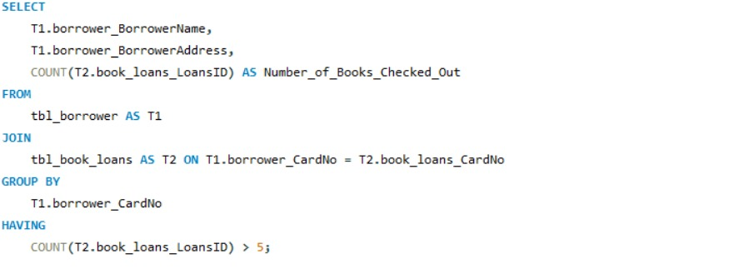
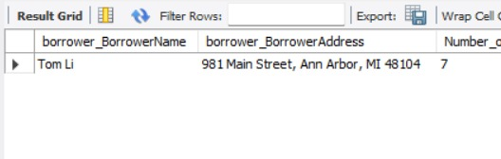
6.Retrieve the names, addresses, and number of books checked out for all borrowers who have more than five books checked out.?
Query:
Output:

Slide 16
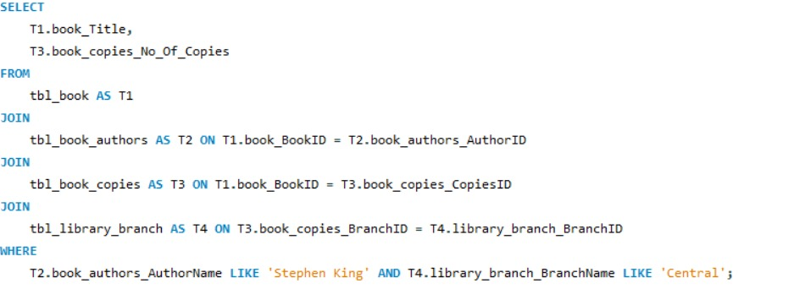
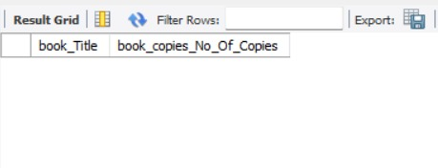
7.For each book authored by "Stephen King", retrieve the title and the number of copies owned by the library branch whose name is "Central“?
Query:
Output:

Slide 17
Final business insights and recommendations
✓ The library data shows clear differences in book demand across branches, with some branches issuing more books than others.
✓ Certain authors and titles are consistently popular, highlighting the need for better inventory planning.
✓ A small group of borrowers accounts for most of the book loans, while others remain inactive.
✓ Book copies are unevenly distributed, causing limited availability in some branches.

Slide 18
CONCLUSION
This project helped in understanding how a library’s data can be effectively managed using SQL. By building the database and running queries on real datasets, we were able to observe trends in book usage, borrower activity, and branch-level performance. The analysis shows how organized data and structured queries can support better decision making in daily library operations. Overall, the project demonstrates the value of SQL in managing, analyzing, and improving library services.

Slide 19


